Slide 1
Lecture 11
Xilinx FPGA Memories
ECE 448 – FPGA and ASIC Design with VHDL

Slide 2
Required reading
P. Chu, FPGA Prototyping by VHDL Examples
  Chapter 11, Xilinx Spartan-3 Specific Memory
ECE 448 – FPGA and ASIC Design with VHDL

Slide 3
Recommended reading
XAPP463 Using Block RAM in Spartan-3 Generation FPGAs
Google search: XAPP463
XAPP464 Using Look-Up Tables as Distributed RAM in Spartan-3
Generation FPGAs
Google search: XAPP464
XST User Guide, Section: RAMs and ROMs HDL Coding Techniques
Google search: XST User Guide (PDF)
ISE In-Depth Tutorial, Section: Creating a CORE Generator Software Module
Google search: ISE In-Depth Tutorial
ECE 448 – FPGA and ASIC Design with VHDL

Slide 4
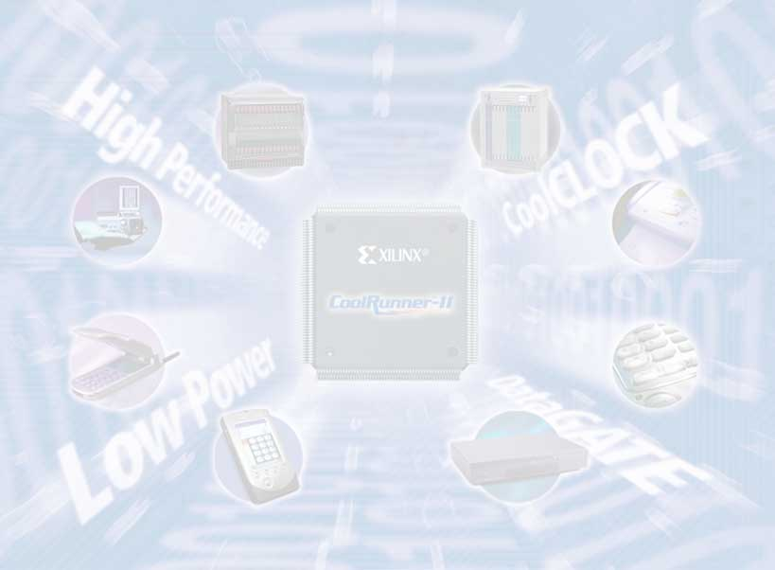
Memory Types

Slide 5
Memory Types
Memory
RAM
ROM
Memory
Single port
Dual port
Memory
With asynchronous
read
With synchronous
read

Slide 6
Memory Types
Memory
Distributed
(MLUT-based)
Block RAM-based
(BRAM-based)
Memory
Inferred
Instantiated
Manually
Using Core Generator

Slide 7
FPGA Distributed
Memory

Slide 8
CLB Slice
COUT
Look-Up
Table
Carry
&
Control
Logic
YB
G4
G3
G2
G1
Y
D
S
O
Q
CK
EC
R
F5IN
BY
SR
Look-Up
Table
Carry
&
Control
Logic
XB
F4
F3
F2
F1
X
S
O
D
Q
CK
EC
R
CIN
CLK
CE
SLICE

Slide 9
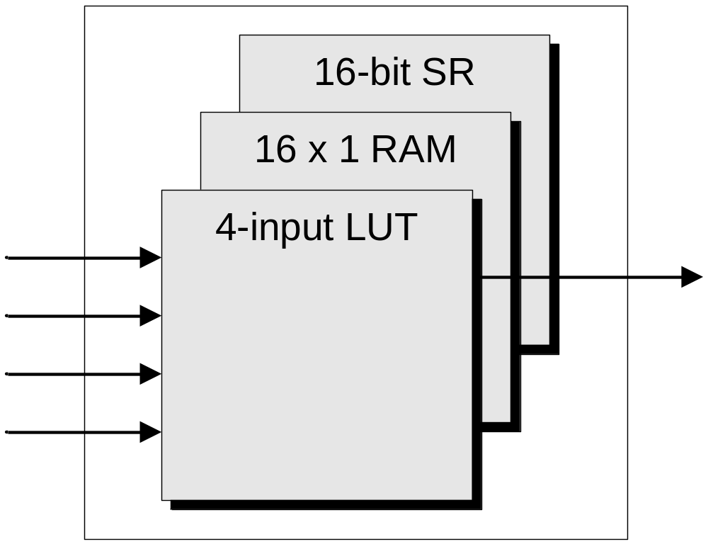
Xilinx Multipurpose LUT (MLUT)
16 x 1 ROM
(logic)
The Design Warrior’s Guide to FPGAs
Devices, Tools, and Flows. ISBN 0750676043
Copyright © 2004 Mentor Graphics Corp. (www.mentor.com)

Slide 10
Distributed RAM
RAM16X1S
CLB LUT configurable as Distributed RAM
  An LUT equals 16x1 RAM
  Cascade LUTs to increase RAM size
Synchronous write
Asynchronous read
  Can create a synchronous read by using extra flip-flops
  Naturally, distributed RAM read is asynchronous
Two LUTs can make
  32 x 1 single-port RAM
  16 x 2 single-port RAM
  16 x 1 dual-port RAM
LUT
D
=
WE
WCLK
O
A0
A1
A2
A3
RAM32X1S
D
WE
WCLK
A0
O
LUT
A1
A2
A3
A4
or
RAM16X2S
D0
D1
=
WE
WCLK
O0
RAM16X1D
A0
O1
D
LUT
A1
A2
WE
A3
WCLK
or
A0
SPO
A1
A2
A3
DPRA0
DPO
DPRA1
DPRA2
DPRA3
Notes:
When the CLB LUT is configured as memory, it can implement 16x1 synchronous RAM. One LUT can implement 16x1 Single-Port RAM. Two LUTs are used to implement 16x1 dual port RAM. The LUTs can be cascaded for desired memory depth and width.
The write operation is synchronous. The read operation is asynchronous and can be made synchronous by using the accompanying flip flops of the CLB LUT.
The distributed ram is compact and fast which makes it ideal for small ram based functions.

Slide 11
FPGA Block RAM

Slide 12
Block RAM
Port A
Spartan-3
Dual-Port
Block RAM
Port B
Block RAM
Most efficient memory implementation
  Dedicated blocks of memory
Ideal for most memory requirements
  4 to 104 memory blocks
    18 kbits = 18,432 bits per block (16 k without parity bits)
  Use multiple blocks for larger memories
Builds both single and true dual-port RAMs
Synchronous write and read (different from distributed RAM)
Notes:
The Block Ram is true dual port, which means it has 2 independent Read and Write ports and these ports can be read and/or written simultaneously, independent of each other. All control logic is implemented within the RAM so no additional CLB logic is required to implement dual port configuration.
The Altera 10KE and ACEX 1K families have only 2-port RAM. To emulate dual port capability, they would need twice the number of memory blocks and at half the performance.

Slide 13
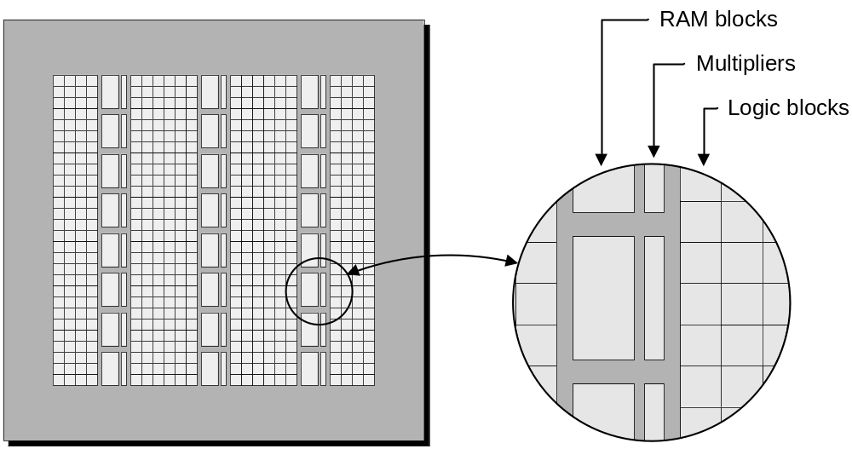
RAM Blocks and Multipliers in Xilinx FPGAs
The Design Warrior’s Guide to FPGAs
Devices, Tools, and Flows. ISBN 0750676043
Copyright © 2004 Mentor Graphics Corp. (www.mentor.com)

Slide 14
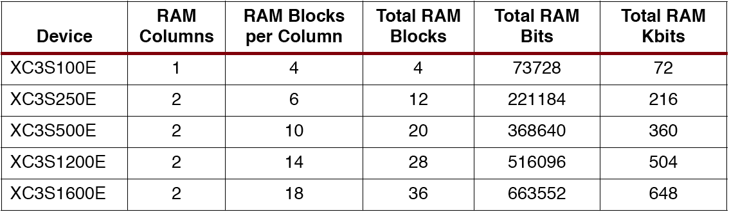
Spartan-3E Block RAM Amounts

Slide 15
Block RAM can have various configurations (port aspect ratios)
1
2
0
0
4
0
8k x 2
4k x 4
4,095
16k x 1
8,191
8+1
0
2k x (8+1)
2047
16+2
0
1024 x (16+2)
1023
16,383

Slide 16
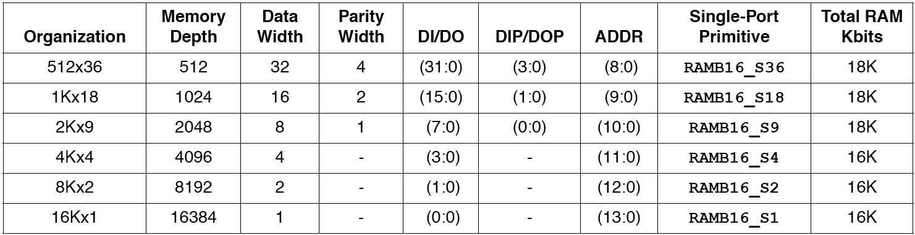
Block RAM Port Aspect Ratios

Slide 17
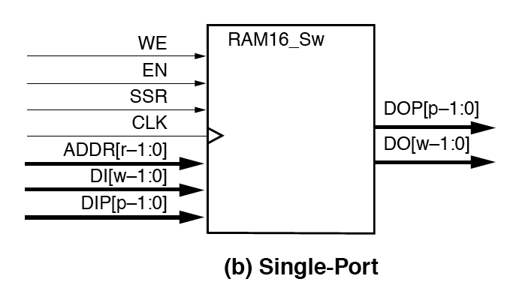
Single-Port Block RAM

Slide 18
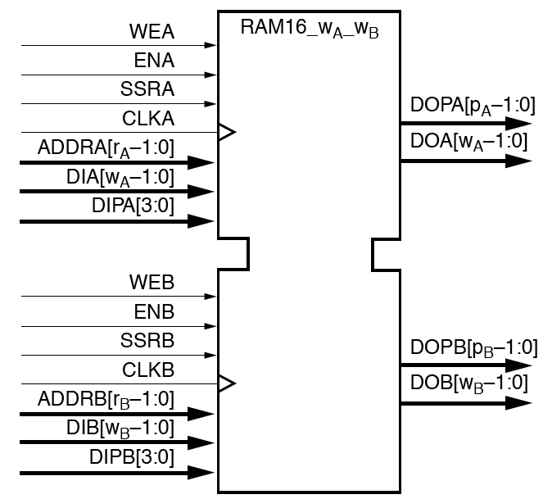
Dual-Port Block RAM
[p_{A}-1:0]
[p_{B}-1:0]

Slide 19
Inference
vs.
Instantiation

Slide 20
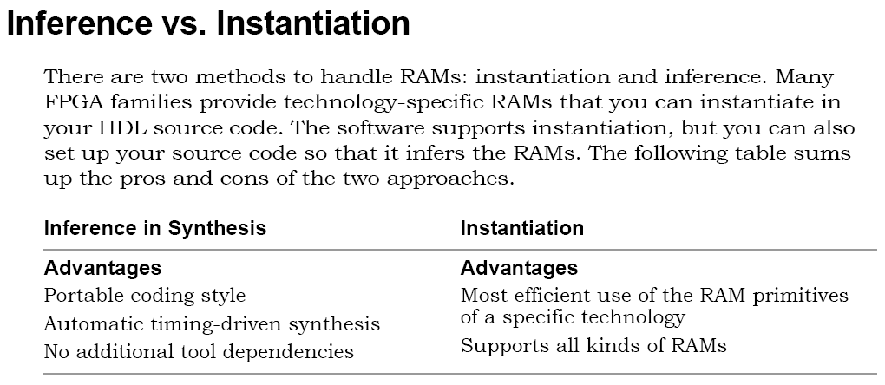

Slide 21
Generic
Inferred
ROM

Slide 22
Distributed ROM with asynchronous read
LIBRARY ieee;
USE ieee.std_logic_1164.all;
USE ieee.std_logic_arith.all;
Entity ROM is
generic ( w : integer := 12;
-- number of bits per ROM word
r : integer := 3);
-- 2^r = number of words in ROM
port (addr : in std_logic_vector(r-1 downto 0);
dout : out std_logic_vector(w-1 downto 0));
end ROM;

Slide 23
Distributed ROM with asynchronous read
architecture behavioral of rominfr is
type rom_type is array (2**r-1 downto 0)
of std_logic_vector (w-1 downto 0);
constant ROM_array : rom_type :=
("000011000100",
"010011010010",
"010011011011",
"011011000010",
"000011110001",
"011111010110",
"010011010000",
"111110011111");
begin
dout <= ROM_array(conv_integer(unsigned(addr)));
end behavioral;

Slide 24
Distributed ROM with asynchronous read
architecture behavioral of rominfr is
type rom_type is array (2**r-1 downto 0)
of std_logic_vector (w-1 downto 0);
constant ROM_array : rom_type :=
("0C4",
"4D2",
"4DB",
"6C2",
"0F1",
"7D6",
"4D0",
"F9F");
begin
dout <= ROM_array(conv_integer(unsigned(addr)));
end behavioral;

Slide 25
Generic
Inferred
RAM

Slide 26
Distributed versus Block RAM Inference
Examples:
  Distributed single-port RAM with asynchronous read
  Distributed dual-port RAM with asynchronous read
  Single-port Block RAM with synchronous read (no version with asynchronous read!)
  More RAM coding examples in the XST Coding Guidelines.

Slide 27
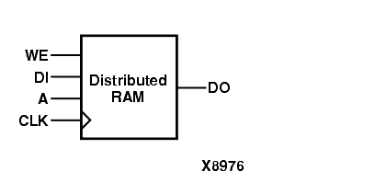
Distributed RAM with asynchronous read

Slide 28
Distributed single-port RAM with asynchronous read
LIBRARY ieee;
USE ieee.std_logic_1164.all;
USE ieee.std_logic_arith.all;
entity raminfr is
generic ( w : integer := 32;
-- number of bits per RAM word
r : integer := 3);
-- 2^r = number of words in RAM
port (clk : in std_logic;
we : in std_logic;
a : in std_logic_vector(r-1 downto 0);
di : in std_logic_vector(w-1 downto 0);
do : out std_logic_vector(w-1 downto 0));
end raminfr;

Slide 29
Distributed single-port RAM with asynchronous read
architecture behavioral of raminfr is
type ram_type is array (2**r-1 downto 0)
of std_logic_vector (w-1 downto 0);
signal RAM : ram_type;
begin
process (clk)
begin
if (clk'event and clk = '1') then
if (we = '1') then
RAM(conv_integer(unsigned(a))) <= di;
end if;
end if;
end process;
do <= RAM(conv_integer(unsigned(a)));
end behavioral;

Slide 30
Report from Synthesis
Resource Usage Report for raminfr
Mapping to part: xc3s50pq208-5
Cell usage:
GND 1 use
RAM16X4S 8 uses
I/O ports: 69
I/O primitives: 68
IBUF 36 uses
OBUF 32 uses
BUFGP 1 use
I/O Register bits: 0
Register bits not including I/Os: 0 (0%)
RAM/ROM usage summary
Single Port Rams (RAM16X4S): 8
Global Clock Buffers: 1 of 8 (12%)
Mapping Summary:
Total LUTs: 32 (2%)

Slide 31
Report from Implementation
Design Summary:
Number of errors: 0
Number of warnings: 0
Logic Utilization:
Logic Distribution:
Number of occupied Slices: 16 out of 768 2%
Number of Slices containing only related logic: 16 out of 16 100%
Number of Slices containing unrelated logic: 0 out of 16 0%
*See NOTES below for an explanation of the effects of unrelated logic
Total Number of 4 input LUTs: 32 out of 1,536 2%
Number used as 16x1 RAMs: 32
Number of bonded IOBs: 69 out of 124 55%
Number of GCLKs: 1 out of 8 12%

Slide 32
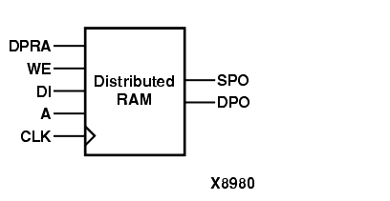
Distributed dual-port RAM with asynchronous read

Slide 33
Distributed dual-port RAM with asynchronous read
library ieee;
use ieee.std_logic_1164.all;
use ieee.std_logic_unsigned.all;
use ieee.std_logic_arith.all;
entity raminfr is
generic ( w : integer := 32;
-- number of bits per RAM word
r : integer := 3);
-- 2^r = number of words in RAM
port (clk : in std_logic;
we : in std_logic;
a : in std_logic_vector(r-1 downto 0);
dpra : in std_logic_vector(r-1 downto 0);
di : in std_logic_vector(w-1 downto 0);
spo : out std_logic_vector(w-1 downto 0);
dpo : out std_logic_vector(w-1 downto 0));
end raminfr;

Slide 34
Distributed dual-port RAM with asynchronous read
architecture syn of raminfr is
type ram_type is array (2**r-1 downto 0) of std_logic_vector (w-1 downto 0);
signal RAM : ram_type;
begin
process (clk)
begin
if (clk'event and clk = '1') then
if (we = '1') then
RAM(conv_integer(unsigned(a))) <= di;
end if;
end if;
end process;
spo <= RAM(conv_integer(unsigned(a)));
dpo <= RAM(conv_integer(unsigned(dpra)));
end syn;

Slide 35
Report from Synthesis
Resource Usage Report for raminfr
Mapping to part: xc3s50pq208-5
Cell usage:
GND 1 use
I/O ports: 104
I/O primitives: 103
IBUF 39 uses
OBUF 64 uses
BUFGP 1 use
I/O Register bits: 0
Register bits not including I/Os: 0 (0%)
RAM/ROM usage summary
Dual Port Rams (RAM16X1D): 32
Global Clock Buffers: 1 of 8 (12%)
Mapping Summary:
Total LUTs: 64 (4%)

Slide 36
Report from Implementation
Design Summary:
Number of errors: 0
Number of warnings: 0
Logic Utilization:
Logic Distribution:
Number of occupied Slices: 32 out of 768 4%
Number of Slices containing only related logic: 32 out of 32 100%
Number of Slices containing unrelated logic: 0 out of 32 0%
*See NOTES below for an explanation of the effects of unrelated logic
Total Number of 4 input LUTs: 64 out of 1,536 4%
Number used for Dual Port RAMs: 64
(Two LUTs used per Dual Port RAM)
Number of bonded IOBs: 104 out of 124 83%
Number of GCLKs: 1 out of 8 12%

Slide 37
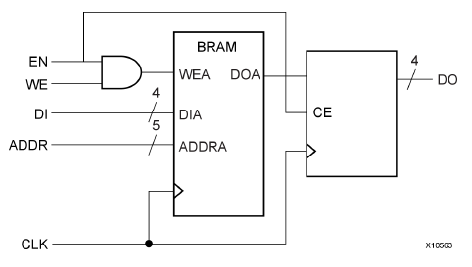
Block RAM with synchronous read in Read-First Mode
RAM
Register

Slide 38
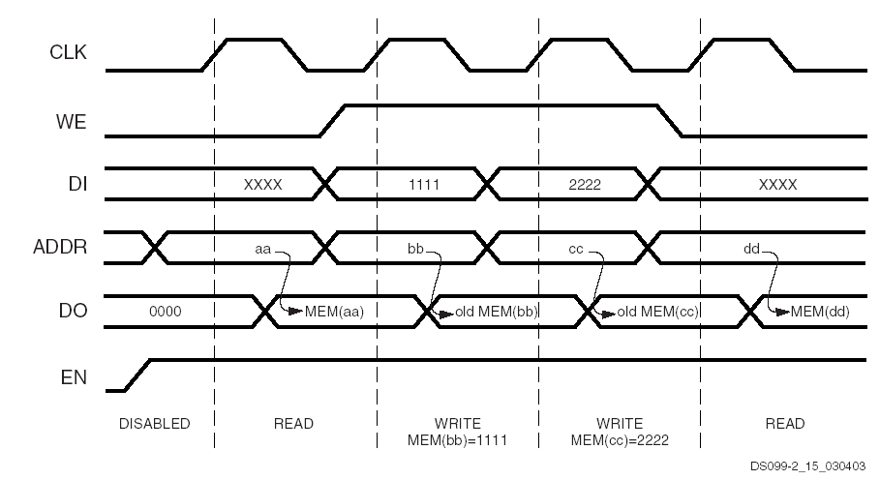
Block RAM Waveforms – READ_FIRST mode

Slide 39
Block RAM with synchronous read
Read-First Mode
LIBRARY ieee;
USE ieee.std_logic_1164.all;
USE ieee.std_logic_arith.all;
entity raminfr is
generic ( w : integer := 32;
-- number of bits per RAM word
r : integer := 9);
-- 2^r = number of words in RAM
port (clk : in std_logic;
we : in std_logic;
en : in std_logic;
addr : in std_logic_vector(r-1 downto 0);
di : in std_logic_vector(w-1 downto 0);
do : out std_logic_vector(w-1 downto 0));
end raminfr;

Slide 40
Block RAM with synchronous read
Read First Mode - cont'd
architecture behavioral of raminfr is
type ram_type is array (2**r-1 downto 0) of
std_logic_vector (w-1 downto 0);
signal RAM : ram_type;
begin
process (clk)
begin
if (clk'event and clk = '1') then
if (en = '1') then
do <= RAM(conv_integer(unsigned(addr)));
if (we = '1') then
RAM(conv_integer(unsigned(addr))) <= di;
end if;
end if;
end if;
end process;
end behavioral;

Slide 41
Report from Synthesis
Resource Usage Report for raminfr
Mapping to part: xc3s50pq208-5
Cell usage:
GND 1 use
RAMB16_S36 1 use
VCC 1 use
I/O ports: 69
I/O primitives: 68
IBUF 36 uses
OBUF 32 uses
BUFGP 1 use
I/O Register bits: 0
Register bits not including I/Os: 0 (0%)
RAM/ROM usage summary
Block Rams : 1 of 4 (25%)
Global Clock Buffers: 1 of 8 (12%)
Mapping Summary:
Total LUTs: 0 (0%)

Slide 42
Report from Implementation
Design Summary:
Number of errors: 0
Number of warnings: 0
Logic Utilization:
Logic Distribution:
Number of Slices containing only related logic: 0 out of 0 0%
Number of Slices containing unrelated logic: 0 out of 0 0%
*See NOTES below for an explanation of the effects of unrelated logic
Number of bonded IOBs: 69 out of 124 55%
Number of Block RAMs: 1 out of 4 25%
Number of GCLKs: 1 out of 8 12%

Slide 43
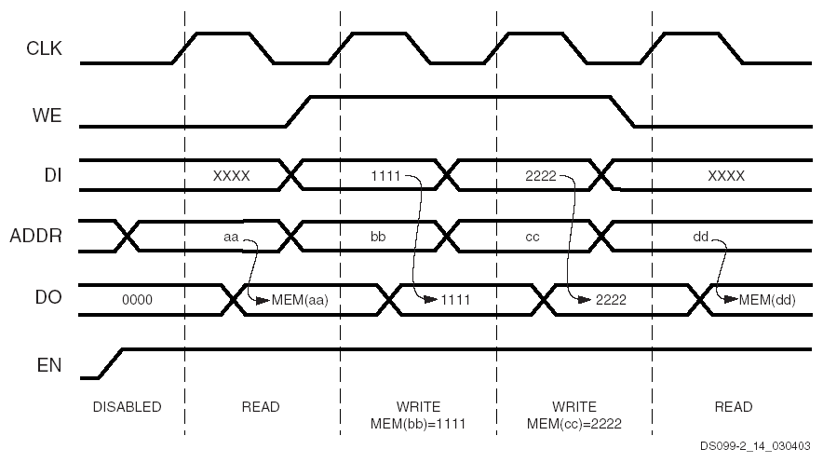
Block RAM Waveforms – WRITE_FIRST mode

Slide 44
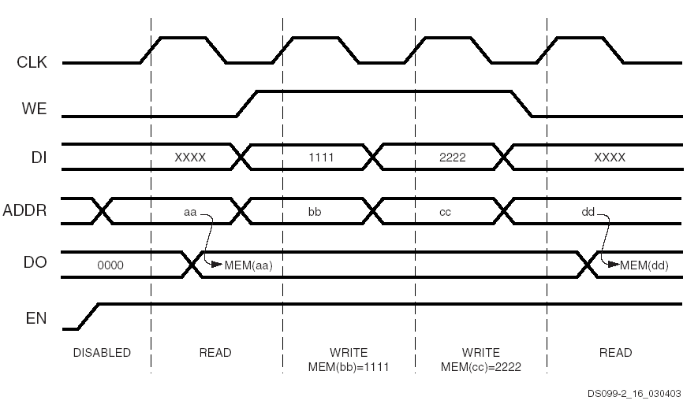
Block RAM Waveforms – NO_CHANGE mode

Slide 45
FPGA
specific memories:
Instantiation

Slide 46
Genaral template of BRAM instantiation (1)
-- Component Attribute Specification for RAMB16_{S1 | S2 | S4}
-- Should be placed after architecture declaration but before the begin
-- Put attributes, if necessary
-- Component Instantiation for RAMB16_{S1 | S2 | S4}
-- Should be placed in architecture after the begin keyword
RAMB16_{S1 | S2 | S4}_INSTANCE_NAME : RAMB16_S1
-- synthesis translate_off
generic map (
INIT => bit_value,
INIT_00 => vector_value,
INIT_01 => vector_value,
……………………………..
INIT_3F => vector_value,
SRVAL=> bit_value,
WRITE_MODE => user_WRITE_MODE)
-- synopsys translate_on
port map (DO => user_DO,
ADDR => user_ADDR,
CLK => user_CLK,
DI => user_DI,
EN => user_EN,
SSR => user_SSR,
WE => user_WE);

Slide 47
Initializing Block RAMs 1024x16
INIT_00 : BIT_VECTOR := X"014A0C0F09170A04076802A800260205002A01C5020A0917006A006800060040";
INIT_01 : BIT_VECTOR := X"000000000000000008000A1907070A1706070A020026014A0C0F03AA09170026";
INIT_02 : BIT_VECTOR := X"0000000000000000000000000000000000000000000000000000000000000000";
INIT_03 : BIT_VECTOR := X"0000000000000000000000000000000000000000000000000000000000000000";
……………………………………………………………………………………………………………………………………
INIT_3F : BIT_VECTOR := X"0000000000000000000000000000000000000000000000000000000000000000")
DATA
ADDRESS
INIT_00
ADDRESS
014A
0F
0C0F
0E
0917
04
006A
03
0068
02
0006
01
0040
00
INIT_01
ADDRESS
0000
1F
0000
1E
014A
14
0C0F
13
03AA
12
0917
11
0026
10
Addresses are shown in red and data corresponding to the same memory location is shown in black
INIT_3F
ADDRESS
0000
FF
0000
FE
0000
F4
0000
F3
0000
F2
0000
F1
0000
F0

Slide 48
Component declaration for BRAM (2)
VHDL Instantiation Template for RAMB16_S9, S18 and S36
-- Component Declaration for RAMB16_{S9 | S18 | S36}
component RAMB16_{S9 | S18 | S36}
-- synthesis translate_off
generic (
INIT : bit_vector := X"0";
INIT_00 : bit_vector := X"0000000000000000000000000000000000000000000000000000000000000000";
INIT_3E : bit_vector := X"0000000000000000000000000000000000000000000000000000000000000000";
INIT_3F : bit_vector := X"0000000000000000000000000000000000000000000000000000000000000000";
INITP_00 : bit_vector := X"0000000000000000000000000000000000000000000000000000000000000000";
INITP_07 : bit_vector := X"0000000000000000000000000000000000000000000000000000000000000000";
SRVAL : bit_vector := X"0";
WRITE_MODE : string := "READ_FIRST"; );

Slide 49
Component declaration for BRAM (2)
-- synthesis translate_on
port (DO : out STD_LOGIC_VECTOR (31 downto 0);
DOP : out STD_LOGIC_VECTOR (3 downto 0);
ADDR : in STD_LOGIC_VECTOR (8 downto 0);
CLK : in STD_ULOGIC;
DI : in STD_LOGIC_VECTOR (31 downto 0);
DIP : in STD_LOGIC_VECTOR (3 downto 0);
EN : in STD_ULOGIC;
SSR : in STD_ULOGIC;
WE : in STD_ULOGIC);
end component;

Slide 50
Genaral template of BRAM instantiation (2)
-- Component Attribute Specification for RAMB16_{S9 | S18 | S36}
-- Component Instantiation for RAMB16_{S9 | S18 | S36}
-- Should be placed in architecture after the begin keyword
RAMB16_{S9 | S18 | S36}_INSTANCE_NAME : RAMB16_S1
-- synthesis translate_off
generic map (
INIT => bit_value,
INIT_00 => vector_value,
. . . . . . . . . .
INIT_3F => vector_value,
INITP_00 => vector_value,
……………
INITP_07 => vector_value
SRVAL => bit_value,
WRITE_MODE => user_WRITE_MODE)
-- synopsys translate_on
port map ( DO => user_DO,
DOP => user_DOP,
ADDR => user_ADDR,
CLK => user_CLK,
DI => user_DI,
DIP => user_DIP,
EN => user_EN,
SSR => user_SSR,
WE => user_WE);

Slide 51
Using
CORE
Generator

Slide 52
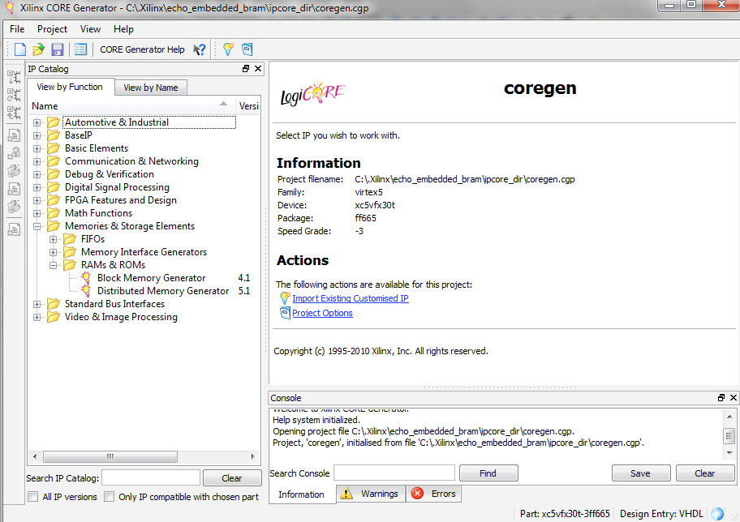
CORE Generator

Slide 53
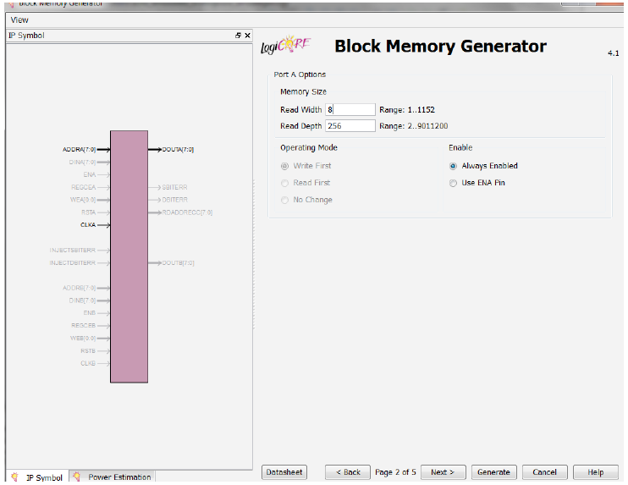
CORE Generator

